Slide 1
Unit 5 Control systems

Slide 2
Stability of closed loop systems
“ A closed-loop feedback control system is stable if and only if all roots of the characteristic polynomial lies on left half of complex(S) plane”.
1. Routh array: Test for positivity of roots of a polynomial
2. Direct substitution: Complex axis separates stable and unstable regions . Find controller gain that yields purely complex roots
3. Root locus diagram: Vary location of poles as controller gain is varied.

Slide 3

SISO control system
A system can be defined as a mathematical relationship between the input, output and the states of a system. In control theory, a system is represented a rectangle with an input and output.
where:
u(t)–input y(t)–output
Both input and output are variable in time. A system with only one input and output is called SISO (Single Input Single Output) system

Slide 4
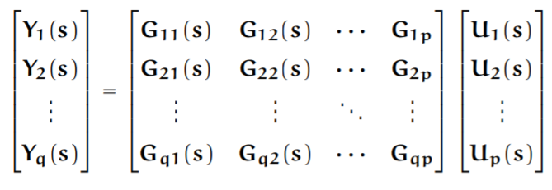
MiMO control system
A system in which the input and the output are vectors, rather than scalars, is a system with Multiple Inputs and Multiple Outputs (a MIMO system), sometimes also called a multivariable system
In MIMO system transfer function of LTI system is represented using a matrix called transfer matrix function

Slide 5
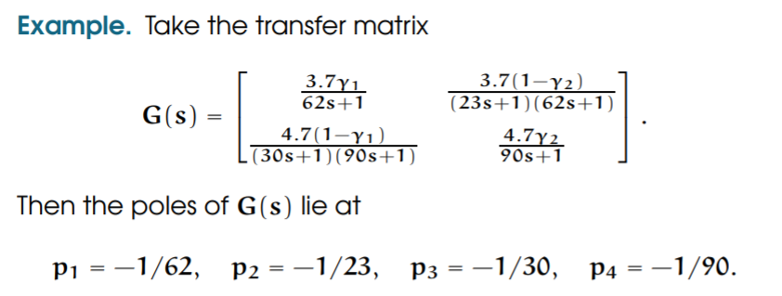
Poles of the MIMO system are the poles of the elements of the transfer matrix
Stability for MIMO systems is as for SISO systems. A continuous-time multivariable system is stable if and only if all its poles lie in the left half plane.
A discrete-time multivariable system is stable if and only if all its poles lie inside the unit circle.
A MIMO system is said to be minimum phase if it has no zeros outside the stability region. Otherwise, it is called non-minimum phase. A continuous-time multivariable system is minimum phase if all its zeros lie in the left half plane. A discrete-time multivariable system is minimum phase if all its zeros lie inside the unit circle.

Slide 6
What is a Controller?
A controller is a mechanism that seeks to minimize the difference between the actual value of a system (i.e. the process variable) and the desired value of the system (i.e. the set point).
Controllers are a fundamental part of control engineering and used in all complex control systems.

Slide 7
important uses of the controllers
The important uses of the controllers include:
Controllers improve the steady-state accuracy by decreasing the steady state error.
As the steady-state accuracy improves, the stability also improves.
Controllers also help in reducing the unwanted offsets produced by the system.
Controllers can control the maximum overshoot of the system.
Controllers can help in reducing the noise signals produced by the system.
Controllers can help to speed up the slow response of an over damped system.
Different varieties of these controllers are codified within industrial automotive devices such as programmable logic controllers and SCADA systems.

Slide 8
Controllers
ON - OFF controller
Proportional controller (P)
Integral controller (I)
Proportional + Integral controller (PI)
Proportional +Derivative Controller (PD)
Proportional +Integral + Derivative Controller (PID)

Slide 9

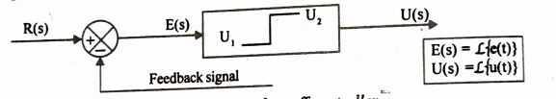
On-Off controller (0r) two position controller
The ON-OFF or two position controller has only two fixed positions. They are either on or off.
The on-off control system is very simple in construction and hence less expensive. For this reason, it is very widely used in both industrial and domestic control systems.
The ON-OFF control action may be provided by a relay. There are different types of relay. The most popular one is electromagnetic relay.
It is device which has NO (Normally Open) and NC (Normally .Closed) contacts, whose opening and closing are controlled by the relay coil. When the relay coil is excited, the relay operates and the contacts change their positions (i.e., NO ➔ NC and NC ➔ NO).
Let the output signal from the controller be u(t) and the actuating error signal be e(t). In this controller, u(t) remains at either a maximum or minimum value.
Block diagram of on-off controller

Slide 10
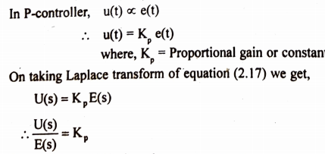
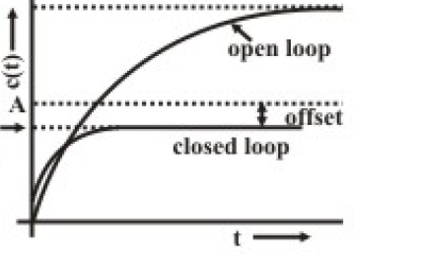
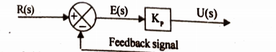
Proportional controller
In a controller, with proportional control action, there is a continuous relationship between the output of the controller (u(t)) (Manipulated Variable) and Actuating Error Signal e(t) (deviation).
output of the P-controller for the input E(s)
Transfer function of the P-controller
Block diagram of Proportional controller
Response

Slide 11
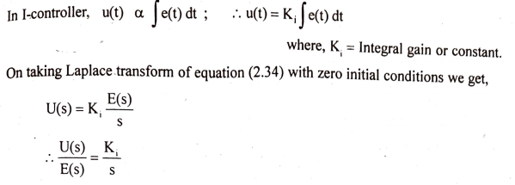
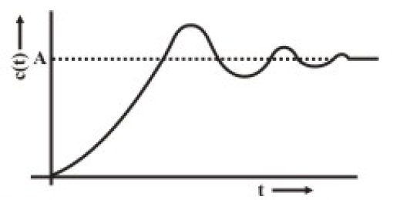
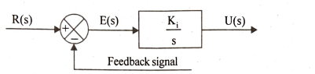
Integral controller
The integral controller is a device that produces a control signal u(t) which is proportional to the integral of the input error signal, e(t).
output of the I-controller for the input E(s)
Transfer function of the I-controller
Block diagram of Integral controller
Response
The integral controller removes or reduces the steady error without the need for manual reset. Hence the I-controller is sometimes called automatic reset. The drawback in integral controller is that it may lead to oscillatory response of increasing or decreasing amplitude which is 3.mdesirable and the system may become unstable

Slide 12
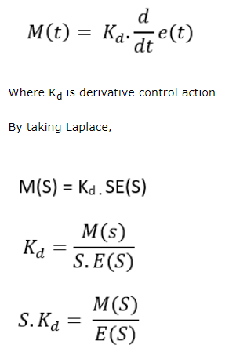
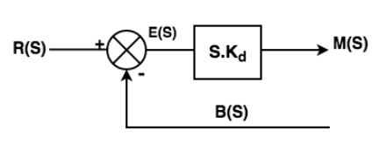
Differential controller
In controller with derivative control action the output of the controller depends on the rate of change of the e(t)
Block diagram of Differential controller

Slide 13
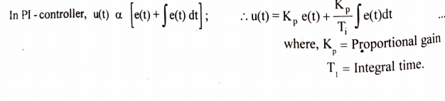
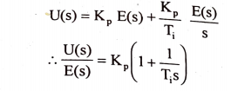
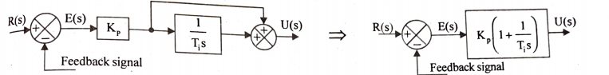
PI controller
The proportional plus integral controller (pi-controller) produces an output signal consisting of two terms : one proportional to error signal and the other proportional to the integral of error signal.
........(1)
On taking Laplace transform of the equation (1) with zero initial conditions we get,
Block diagram of PI- controller

Slide 14
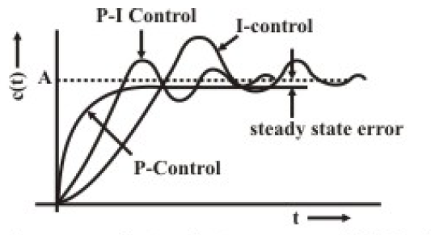
PI controller
The advantages of both P-controller and I-controller are combined in PI-controller.
The proportional action increases the loop gain and makes the system less sensitive to variations of system parameters.
The integral action eliminates or reduces the steady state error.
The integral control action is adjusted by varying the integral time.
The change in value of KP affects both the proportional and integral parts of control action. The inverse of the integral time Ti is called the reset rate.

Slide 15
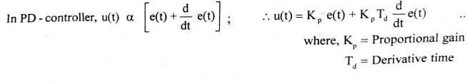

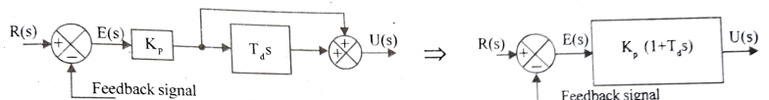
PD controller
The proportional plus derivative controller produces an output signal consisting of two terms : one proportional to error signal and the other proportional to the derivative of error signal.
........(1)
On taking Laplace transform of the equation (1) with zero initial conditions we get,
Block diagram of PD- controller

Slide 16
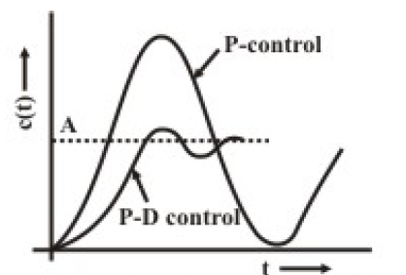
PD controller
The derivative control acts on rate of change of error and not on the actual error signal . The derivative control action is effective during transient periods and so it does not produce corrective measures for any constant error
Hence the derivative controller is never used alone, but it is employed in association with proportional and integral controllers. The derivative controller does not affect the steady state error directly but antipates the error, initiates an early corrective action and tends to increase the stability of the system. While derivative control action has an advantage of being anticipatory it has the disadvantage that it amplifies noise signals and may cause a saturation effect in the actuator.
The derivative control action is adjusted by varying the derivative time. The change in the value KP affects both the proportional and derivative parts of control action. The derivative control is also called rate control.

Slide 17
The Characteristics of P, I, and D controllers
A proportional controller (Kp) will have the effect of reducing the rise time and will reduce, but never eliminate, the steady-state error.
An integral control (Ki) will have the effect of eliminating the steady-state error, but it may make the transient response worse.
A derivative control (Kd) will have the effect of increasing the stability of the system, reducing the overshoot, and improving the transient response.

Slide 18
Proportional Control
By only employing proportional control, a steady state error occurs.
Proportional and Integral Control
The response becomes more oscillatory and needs longer to settle, the error disappears.
Proportional, Integral and Derivative Control
All design specifications can be reached.

Slide 19
The Characteristics of P, I, and D controllers
CL RESPONSE
RISE TIME
OVERSHOOT
SETTLING TIME
S-S ERROR
Kp
Decrease
Increase
Small Change
Decrease
Ki
Decrease
Increase
Increase
Eliminate
Kd
Small Change
Decrease
Decrease
Small Change

Slide 20
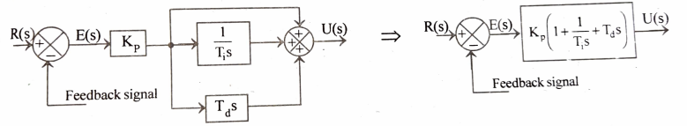
PID controller
Block diagram of PID-controller
The combination of proportional control action, integral control action and derivative control action is called PID-control action. This combined action has the advantages of the each of the three individual control actions. The proportional controller stabilizes the gain but produces a steady state error. The integral controller reduces or eliminates the steady state error. The derivative controller reduces the rate of change of error.

Slide 21
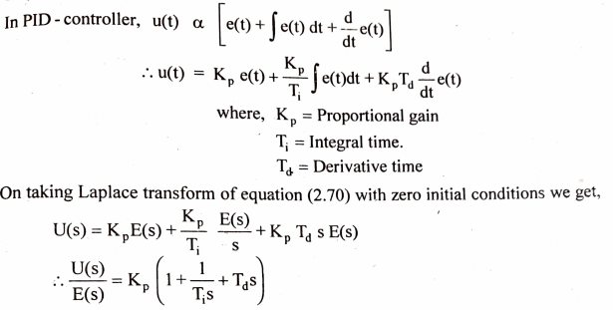
PID controller
The PID-Controller produces an output signal consisting of three terms: one proportional to error signal, another one proportional to integral of error signal and the third one proportional to derivative of error signal.

Slide 22
Tips for Designing a PID Controller
1. Obtain an open-loop response and determine what needs to be improved
2. Add a proportional control to improve the rise time
3. Add a derivative control to improve the overshoot
4. Add an integral control to eliminate the steady-state error
Adjust each of Kp, Ki, and Kd until you obtain a desired overall response.

Slide 23
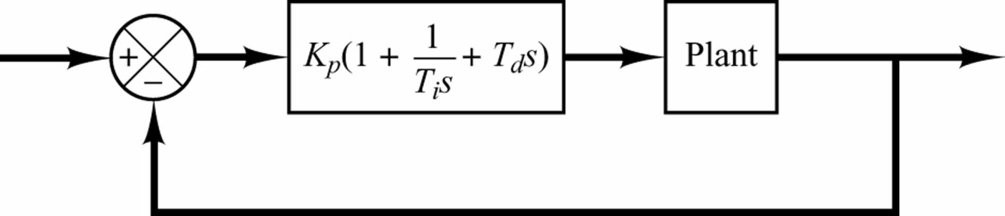
PID control of a plant.
Design PID control
- Know mathematical model  various design techniques
- Plant is complicated, can’t obtain mathematical model 
experimental approaches to the tuning of PID controllers

Slide 24
Ziegler-Nichols Rules for Tuning PID Controllers
Ziegler and Nichols proposed rules for determining values of the proportional gain K_{p}, integral time T_{i}, and derivative time T_{d} based on the transient response characteristics of a given plant.
Such determination of the parameters of PID controllers or tuning of PID controllers can be made by engineers on-site by experiments on the plant.
Such rules suggest a set of values of K_{p}, T_{i}, and T_{d} that will give a stable operation of the system. However, the resulting system may exhibit a large maximum overshoot in the step response, which is unacceptable.
- We need series of fine tunings until an acceptable result is obtained.

Slide 25
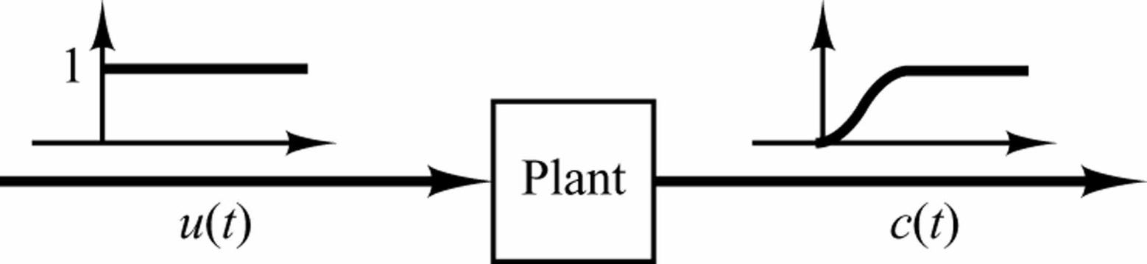
Ziegler-Nichols 1st Method of Tuning Rule
-We obtain experimentally the response of the plant to a unit-step input, as shown in Figure
The plant involves neither integrator(s) nor dominant complex-conjugate poles.
This method applies if the response to a step input exhibits an S-shaped curve.
-Such step-response curves may be generated experimentally or from a dynamic simulation of the plant.
Unit-step response of a plant.

Slide 26
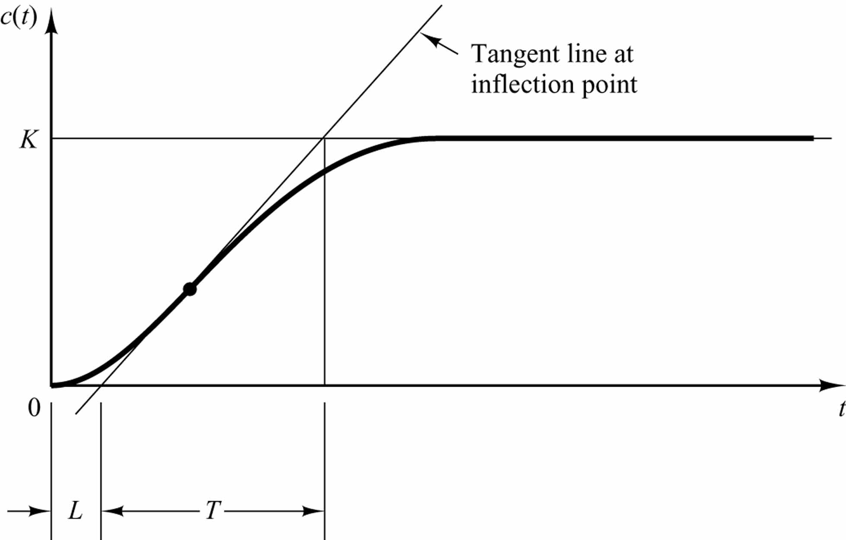
L = delay time
T = time constant
S-shaped response curve.

Slide 27
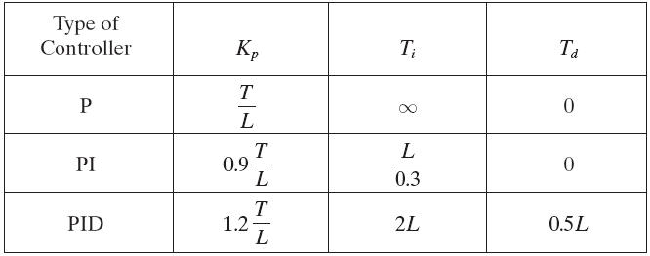
Transfer function:
Table 10.1 Ziegler–Nichols Tuning Rule Based on Step Response of Plant (First Method)

Slide 29
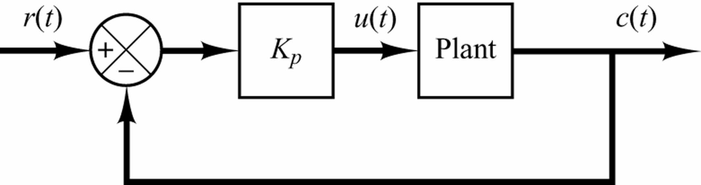
Ziegler-Nichols 2nd Method of Tuning Rule
1. We first set T_{i} = ∞ and T_{d} = 0. Using the proportional control action only (see Figure).
Figure Closed-loop system with a proportional controller.

Slide 30
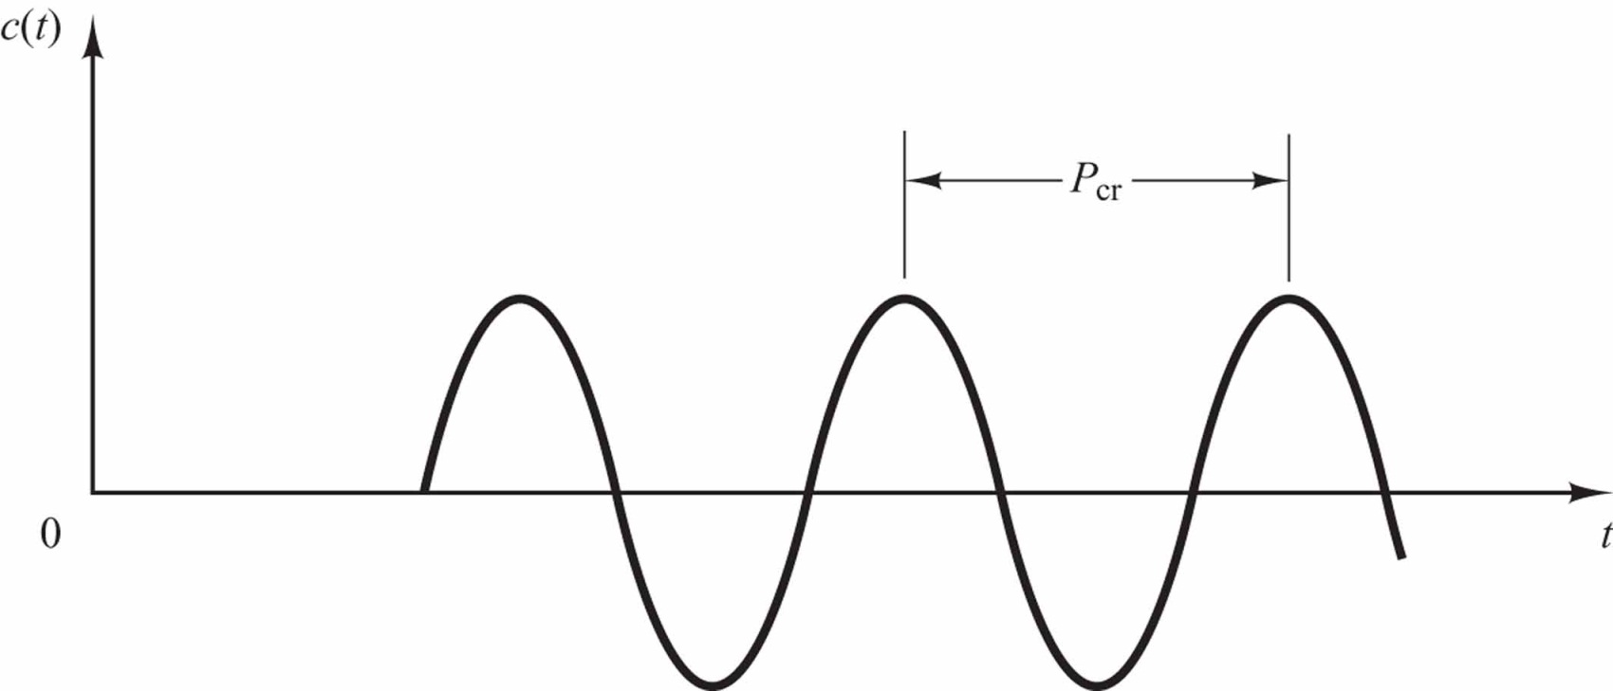
2. Increase K_{p} from 0 to a critical value K_{cr} at which the output first exhibits sustained oscillations.
Sustained oscillation with period P_{cr}. (P_{cr} is measured in sec.)

Slide 31
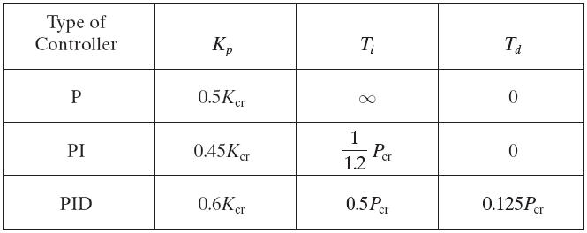
 Ziegler and Nichols suggested that we set the values of the parameters K,, T,, and Td according to the formula shown in Table.
Ziegler–Nichols Tuning Rule Based on Critical Gain K_{cr} and Critical Period P_{cr} (Second Method)

Slide 33
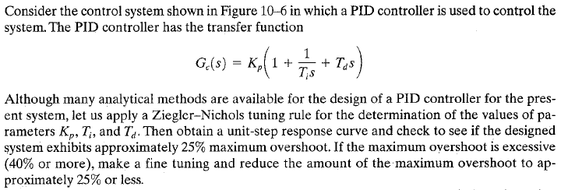
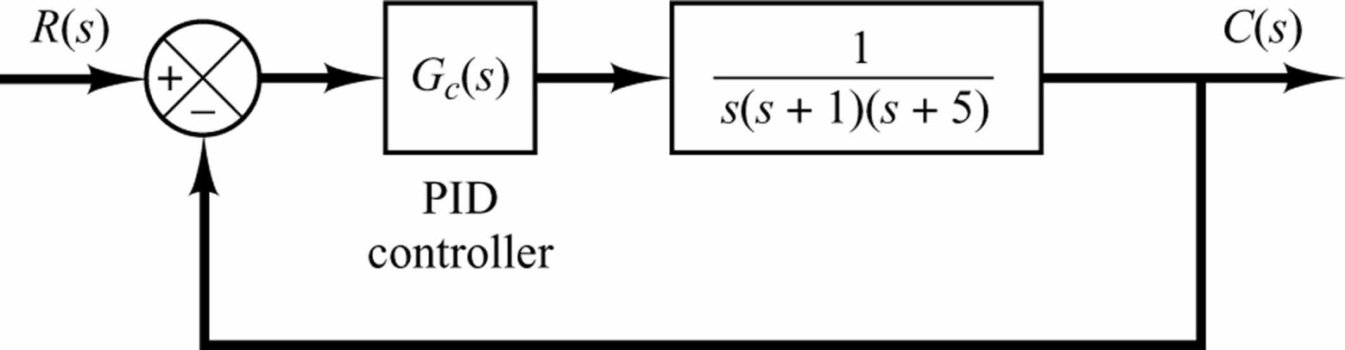
Figure 10-6 PID-controlled system.

Slide 34
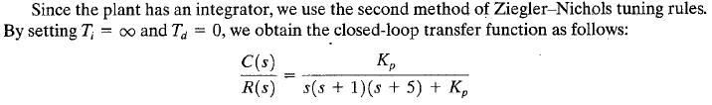

Slide 36
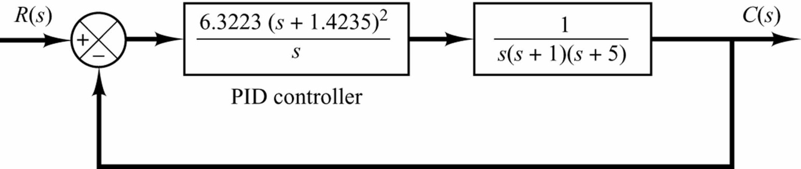
Figure 10-7 Block diagram of the system with PID controller designed by use of the Ziegler–Nichols tuning rule (second method).

Slide 38
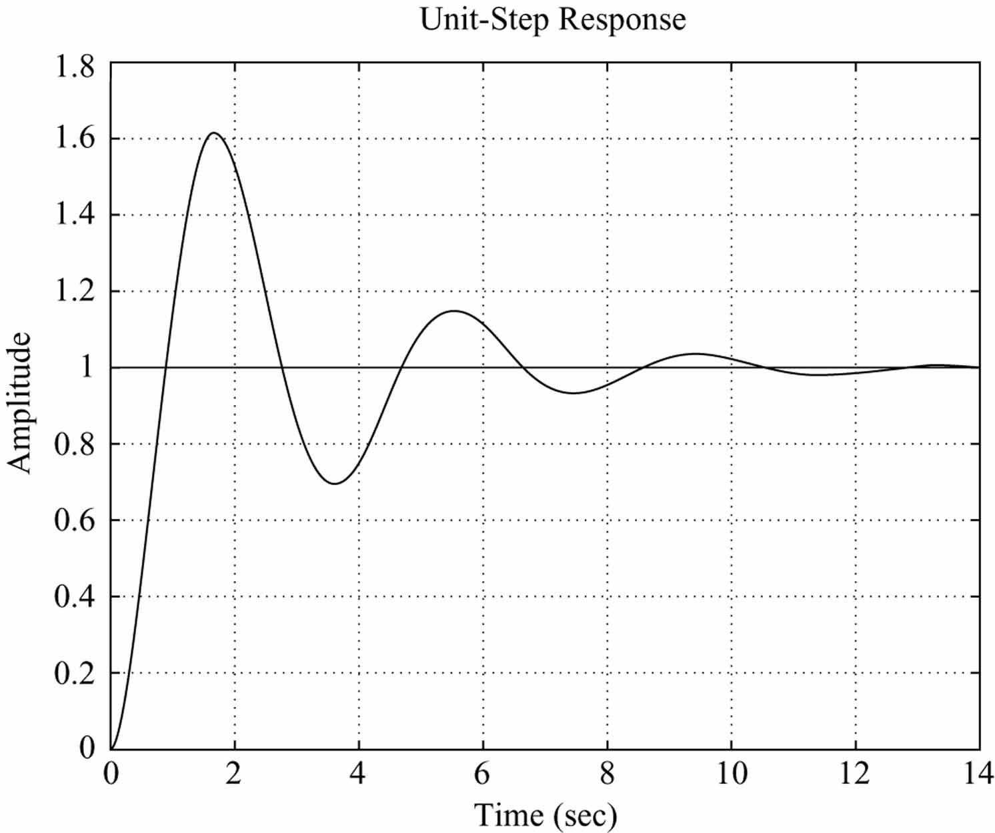
Unit-step response curve of PID-controlled system designed by use of the Ziegler–Nichols tuning rule (second method).

Slide 39
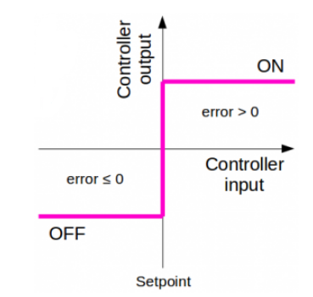
Design Specification , controller configuration On-Off controller
The on-off control is the simplest form of a controller, which switches ON when the error is positive and switches OFF when the error is zero or negative. An on-off controller doesn’t have intermediate states but only fully ON or fully OFF states.

Slide 40
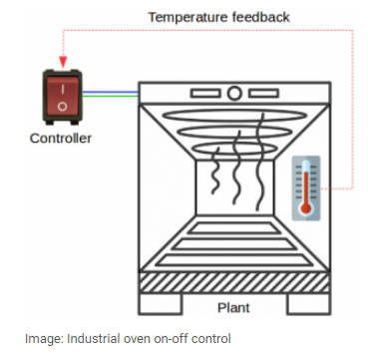
Industrial oven on-off control
Let’s take as example the temperature control of an industrial oven. The temperature inside the oven is measured with a sensor and feed back to the controller.
Based on the error (difference between setpoint temperature and measured temperature), the heating elements are turned ON or OFF by the controller.
There are no intermediate values of the heating element, they are fully ON or fully OFF.

Slide 41
If we compare this system with the generic closed-loop system explained above, we can identify the following elements:
controller: switch
plant: oven
feedback (measured output): temperature
The industrial oven has two important characteristics which need to be explained, because they affect the response of the controller:
dead time
capacitance (inertia)
In most of the control systems with feedback loop, the system can not respond instantly to any disturbance and it takes time (delay) until the controller output has any effect on the measured (plant) output. This time delay is know as dead time.
In the case of the industrial oven, if the access door is opened, it takes time until the temperature drops, the controller senses the difference, turns the heaters on and the temperature is brought back to setpoint. Dead time has the effect of hiding the disturbance from the controller and limits its ability to react quickly.
The capacitance of a system is seen as the resistance to changing inputs. The higher the capacitance of a system, the longer the time it takes to react to changes. With the oven cold, even if turning the heaters on, takes time for the temperature to start increasing and reach the nominal value. The advantage is that capacitance has the tendency to filter (dampen) out the effect of disturbances on a system.

Slide 42

In the theory of control systems, the industrial oven is defined as a first order process with dead time. The transfer function of a first order process with dead time is:
where:
K – gain T – time constant τ – dead time
The time constant is a measure of the capacitance of the system. The higher the time constant, the longer it takes for the system to react to changing inputs or disturbances.

Slide 43

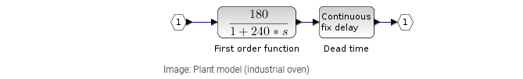
Example 1. Implement an on-off controller for an industrial oven temperature control system with the following parameters:
open loop response of the oven at step input: 180 °C
time constant of the oven: 240 s
dead time of the process: 30 s
which will control the temperature for a set point of 120°C.
From the input parameters, we can write the transfer function of the plant as:
The plant can be modelled as a first order Transfer Function with a Continuous fix delay:

Slide 44
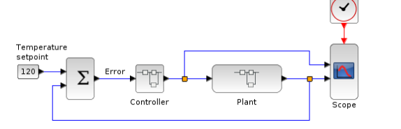
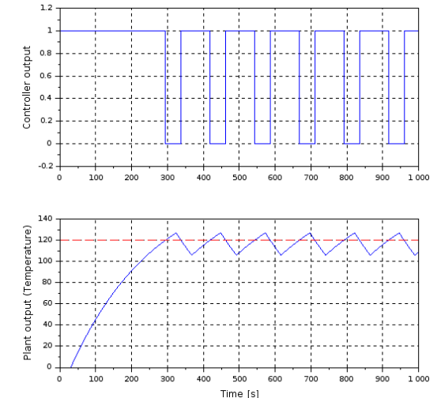
The error is calculated as the difference between the setpoint and the current value of the temperature (plant output). Both the plant model and on-off controller are grouped together under the Function blocks.
The simulation is run for 1000 s. The controller output and the plant output are plotted in the image below.

Slide 45
Speed control system for DC motor
Armature controlled DC motor
Field controlled DC motor.

Slide 46
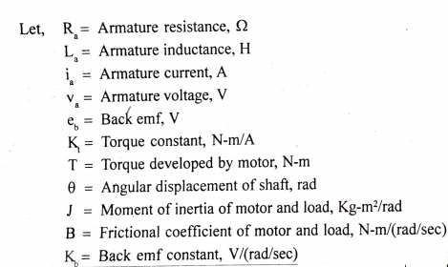
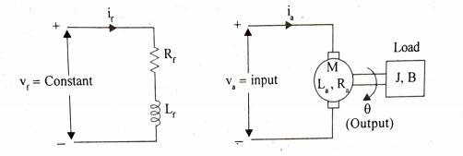
Armature controlled dc motor
The speed of the DC motor is directly proportional to armature voltage and inversely proportional to flux in field windings.
In armature controlled DC motor speed is obtained by varying the armature voltage.
Speed control system is electro mechanical control system.
Electrical system consists of armature and mechanical system consists of rotating part of the motor and the load connected to the shaft of the motor.
Fig1: Armature controlled DC motor

Slide 47
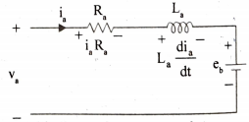




The equivalent circuit of armature is shown in fig 2.
By Kirchhoff's voltage law, we can write,
....1
Torque of DC motor is proportional to the product of flux and current. Since flux is constant in this system, the torque proportional to ia, alone.
Fig 2: Equivalent circuit of armature.
....2
The mechanical system of the motor is shown in fig 3. The differential equation governing the mechanical system of motor is given by,
Fig 3: mechanical system of the motor.
....3

Slide 48

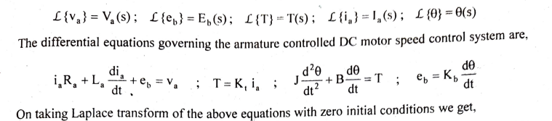
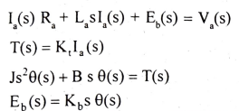
The back emf of DC machine is proportional to speed (angular velocity) of shaft.
....4
The Laplace transform of various time domain signals involved in this system are shown below
....5
....6
....7
....8

Slide 49
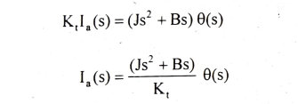

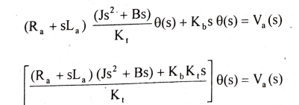
On equating equations (6) and (7) we get,
....9
Equation (5) can be written as,
....10
Substituting for E (s) and I,(s) from equation (8) and (9) respectively in equation (10),
....11

Slide 50
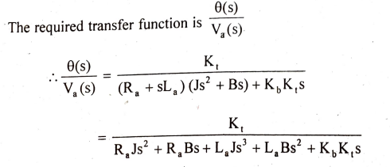
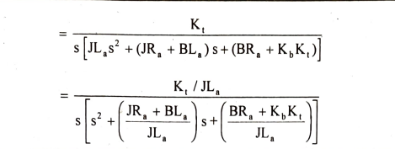
....11

Slide 51

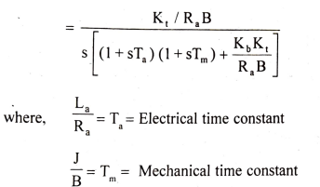
The transfer function of armature controlled de motor can be expressed in another standard form as shown below. From equation (11) we get,

Slide 52
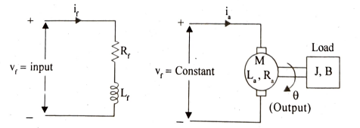
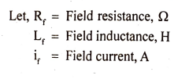
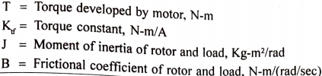
Field controlled dc motor
In field controlled DC motor the speed is varied by varying flux of the machine and armature voltage is kept constant.
Since flux is directly proportional to field current, flux is varied by varying field current.
The electrical system consists of armature and the mechanical system consists of rotating part of the motor and the load connected to shat of the motor.
Fig1:Field controlled DC motor

Slide 53





The equivalent circuit of field is shown in fig2.
By Kirchoff 's voltage law, we can write
......1
Fig 2: Equivalent circuit of field
The torque of DC motor is proportional to product of flux and armature current. Since armature current is constant in this system, the torque is proportional to flux alone, but flux is proportional to field current.
Fig 3: Mechanical system of the motor
......2
The mechanical system of the motor is shown in fig 3. The differential equation governing the mechanical system of the motor is given by,
......3

Slide 54



......4
......5
......6
Equating equations (5) and (6) we get,
......7
The equation (4) can be written as,
......8

Slide 55

On substituting for If(s) from equation (7) in equation (8) we get,
......9

Slide 56

Twin Rotor MIMO system
The main objective of designing a controller for Twin Rotor MIMO system is to provide a platform through which flight air vehicle such as Helicopter and Unmanned Air Vehicle (UAV)can be controlled.

Slide 57
Aerodynamic model of TRMS is shown in Figure-1.1. It consists of two propellers which are perpendicular to each other and joined by a beam pivoted on its base.
The system can rotate freely in both vertical and horizontal direction.
Both propellers are driven by DC motor and by changing the voltage supplied to beam, rotational speed of propellers can be controlled.
For balancing the beam in steady state, counterweight is connected to the system.
Both propellers are shielded so that the environmental effects can be minimized.
The complete unit is attached to the tower which ensures safe helicopter control experiments.
The electrical unit is placed under the tower which is responsible for communication between TRMS and PC.
The electrical unit is responsible for transfer of measured signal by sensors to PC and transfer of control signal via I/O card.
Main rotor is responsible for controlling the flight of TRMS in vertical direction and Tail rotor is responsible for controlling the flight of TRMS in horizontal direction. There is cross-coupling between Main and Tail rotor.
The TRMS is basically a prototype model of Helicopter. However there is some significant difference in aerodynamically controlling of Helicopter and TRMS. In Helicopter, controlling is done by changing the angle of both rotors, while in TRMS it is done by varying the speed of rotors.

